Slide 1
CISC2003 OOP AND DATA STRUCTURES
1
Lab 8
TA: Lai Qi
yb97447@um.edu.mo
E11-2039
Notes:
Chapter 1 - 1

Slide 2
Outline
2
Get familiar with abstract Stack
Get familiar with array based Stack
Get familiar with singly linked list based stack
Get familiar with abstract Queue
Get familiar with Circular Queue
Get familiar with Deque
Notes:
Chapter 1 - 2

Slide 3
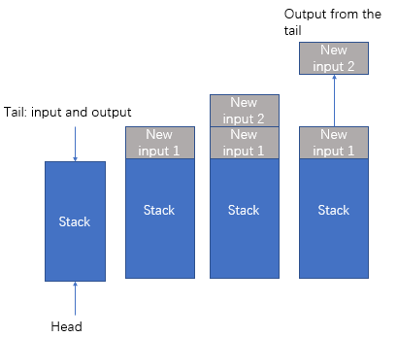
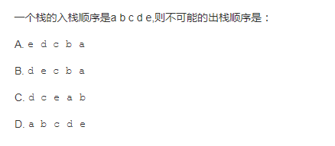
Stack (棧)
3
Only one way in and out. Imagine as a bucket.
Last In First Out (LIFO)
Qusetion:
An input to stack is : a b c d e. Which of the following option is not the right sequence of output.
Notes:
Chapter 1 - 3

Slide 4
Practice1
What values are returned during the following series of stack operations, if executed upon an initially empty stack?
push(5), push(3), pop(), push(2), push(8), pop(), pop(), push(9), push(1), pop(), push(7), push(6), pop(), pop(), push(4), pop(), pop().
8
3
2
9
5
Notes:
Chapter 1 - 4

Slide 5
Practice2: implement with singly linked list
class ListStack<T> {
private class Node<T>{
private T data;
private Node<T> next;
public Node(T t,Node<T> next){
this.data=t;
this.next=next;
}
}
private Node<T> top;
public ListStack(){
top=null;
}
// 向栈中添加新的结点元素: 新节点的next指向原本的top结点;将新的top结点指向新插入的节点
public void push(T t){
Node<T> node=new Node<T>(t,top);
top=node; }
// 栈顶出栈并将新栈顶结点指向原栈顶结点
public T pop() throws Exception{
if(top==null){
throw new Exception("栈为空，元素不可出栈");
}
Node<T> node=top;
top=top.next;
return node.data;
}
//遍历打印栈
public void printfStack(){
Node<T> node=top;
while(node!=null){
System.out.println(node.data);
node=node.next;
}
}
public static void main(String[] args) throws Exception {
ListStack<String> list=new ListStack<String>();
list.push("1");
list.push("2");
list.push("3");
list.pop();
list.printfStack();
}
}
Notes:
Chapter 1 - 5

Slide 6
class ArrayStack {
private int MaxSize;// 定义数组的最大长度
private int[] arr;// 定义数组，数据就放在该数组
private int top = -1;// 定义栈顶，初始化数据为-1
public ArrayStack(int maxSize) {
this.MaxSize = maxSize;
arr = new int[MaxSize];
}
// 判断数组是否为空
public boolean isEmpty() {
return top == -1;
}
// 判断数组是否满了
public boolean isFull() {
System.out.println("栈顶：" + top + "最大长度：" + MaxSize);
return top == MaxSize -1;
}
// 进栈
public void push(int val) {
// 先判断栈是否满了，满了就不能添加进去
if (isFull()) {
System.out.println("栈已经满了~~");
return;
}
top++;
arr[top] = val;
}
// 出栈
public int pop() {
// 先判断栈是否为空
if (isEmpty()) {
throw new RuntimeException("栈为空，无法出栈！");
}
int val = arr[top];
top--;
return val;
}
public void show() {
if (isEmpty()) {
System.out.println("没有数据");
return;
}
for (int i = top; i >= 0; i--) {
System.out.print(arr[i] + "\t");
}
System.out.println();
}
}
Practice3: implement with array
import java.util.Arrays;
import java.util.Scanner;
class ArrayStackDemo {
public static void main(String[] args) {
ArrayStack a = new ArrayStack(5);
boolean flag = true;// 用于判断循环结束的标志
Scanner sc = new Scanner(System.in);
String key = "";// 用于接受菜单的选项
while (flag) {
System.out.println("show：显示栈");
System.out.println("exit：退出程序");
System.out.println("push：进栈");
System.out.println("pop：出栈");
key = sc.nextLine();
switch (key) {
case "show":
a.show();
break;
case "exit":
flag = false;
System.out.println("程序结束！");
break;
case "push":
System.out.println("请输入要进栈的数据：");
int val = sc.nextInt();
a.push(val);
break;
case "pop":
int pop = a.pop();
System.out.println("出栈的值是：" + pop);
}
}
}
}
Notes:
Chapter 1 - 6

Slide 7
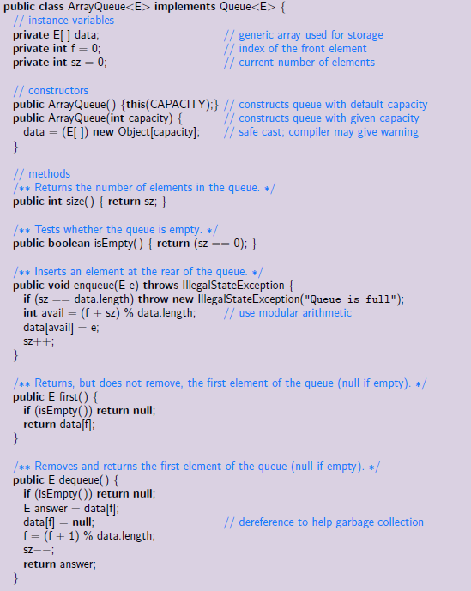
Queue-Java implementation with array
7
Notes:
Chapter 1 - 7

Slide 8
Queue-Java implementation with linked list
8
class ListQueue<T> {
private Node head;//头结点
private Node tail;//尾结点
private int size;//队列中元素的个数
class Node {
private Node next;//下一个结点
private T t;//结点的数据
public Node(T t) {
this.t = t;
}
public T getT() {
return t;
}
}
public int size() {
return size;
}
public ListQueue() {
head = tail = null;
}
//入队
public void enqueue(T t) {
Node node = new Node(t);
if (size == 0) {
head = tail = node;
size++;
return;
}
Node lastNode = head;
while (lastNode.next != null) {
lastNode = lastNode.next;
}
lastNode.next = node;
tail = node;
size++;
}
//出队
public T dequeue() {
if (size == 0) {
System.out.println("null");
return null;
}
T t = head.getT();
head=head.next;
size--;
return t;
}
//展示
public void print(){
Node current=head;
while(current!=null){
System.out.print(current.t+" ");
current=current.next;
}
System.out.println();
}
public static void main(String[] args) {
ListQueue<String> q = new ListQueue<>();
q.enqueue("a");
q.enqueue("b");
q.enqueue("c");
q.print();
System.out.println(q.dequeue());
q.print();
System.out.println(q.size());
}
}
Notes:
Chapter 1 - 8

Slide 9
Practice1
9
What values are returned during the following sequence of queue operations, if executed on an initially empty queue?
enqueue(5), enqueue(3), dequeue(), enqueue(2), enqueue(8), dequeue(), dequeue(), enqueue(9), enqueue(1), dequeue(), enqueue(7), enqueue(6), dequeue(), dequeue(), enqueue(4), dequeue(), dequeue().
refer to lecture notes Stacks and Queues, slide 33,35.
Notes:
Chapter 1 - 9

Slide 10
Practice2
10
Suppose you have a deque D containing the numbers (1,2,3,4,5,6,7,8), in this order. Suppose further that you have an initially empty queue Q. Give a code fragment that uses only D and Q (and no other variables) and results in D storing the elements in the order (1,2,3,5,4,6,7,8).
Notes:
Chapter 1 - 10

Slide 11
Practice2: reference
11
Assume: a deque D with elements 1,2,3,4,5,6,7,8 and an initially empty queue Q
Code fragment:
D.addLast(D.removeFirst());//1
D.addLast(D.removeFirst());//2
D.addLast(D.removeFirst());//3
D.addLast(D.removeFirst());//4
Q.enqueue(D.removeFirst());//5
Q.enqueue(D.removeLast());//4
D.addLast(Q.dequeue());//5
D.addLast(Q.dequeue());//4
D.addLast(D.removeFirst());//6
D.addLast(D.removeFirst());//7
D.addLast(D.removeFirst());//8
refer to lecture notes Stacks and Queues, slide 33,35,56,57.
Notes:
Chapter 1 - 11

Slide 12
Exercise: parentheses matching
12
1. Make pair for inputs of brackets (realize with stack)
Input:
Inputs are only [ , ] , ( , ) , [ and ] are a pair , ( and ) are a pair.
Output:
If the inputs bracket are all paired, output yes, if not, output No
Example: (Stacks and Queues, Slide 20)
Input output
[(]) No
(]) No
([[]()]) Yes
2. Implementing a Deque with a Doubly Linked List.
Submission Guideline
1. Please submit .java file and screenshot to UMMoodle.
2. Do not copy your classmate’s codes, otherwise both of you will lose scores.
3.Submission deadline: 11:50pm, 16/11/2022.
(It will better if you can submit at the end of this lab.)
Notes:
Chapter 1 - 12

